Slide 1
Cloud Nowcasting through Diffusion Models
AI in Industry Project
- Master Course in Artificial Intelligence -

Slide 2
Table of contents
01
02
03
04
Introduction
Methodology
Implementation
Results

Slide 3
01
Introduction

Slide 4
Objective
Develop models for accurate cloud movement forecasting and short-term weather predictions to enhance weather related applications.

Slide 5
Challenges
Weather nowcasting is complex due to rapidly changing weather systems.
Accurate predictions are vital for applications in solar energy, agriculture, and disaster management, requiring sophisticated modeling of large datasets

Slide 6
Application in energy sector
Optimal Solar Placement
Energy Production Forecasting
Using cloud cover analysis for effective solar panel positioning
Predicting fluctuations in solar energy output
Notes:
Optimal Solar Panel Placement: aids in predicting cloud cover, crucial for determining the most effective locations for solar panels.
Network Output Prediction: more accurate predictions of solar energy production, essential for managing energy supply networks.
Operational Efficiency of Solar Grids: By anticipating changes in power generation due to weather conditions, can enhance the operational efficiency and reliability of solar energy grids.

Slide 7
Data
We used the SEVIR Dataset ¹
It is an annotated, curated, and spatio-temporally aligned dataset containing over 10,000 weather events in the form of consecutive images of clouds from different weather sensors
[1] Veillette et al., “SEVIR: A Storm Event Imagery Dataset for Deep Learning Applications in Radar and Satellite Meteorology”, Curran Associates Inc. 2020, https://dl.acm.org/doi/abs/10.5555/3495724.3497570

Slide 8
Dataset Content
Events
Time Span
Spatial Coverage
+10.000 Weather Events
2018-2019
Patches across the US
of 384 km x 384 km

Slide 9
Dataset catalog
The SEVIR dataset catalog contains 76,004 entries, each with 21 different columns providing detailed information about the weather events captured. Key columns include:
Column Name | Description | Column Name | Description
id | Unique identifier for each entry | event_type | Type of weather event
file_name | Name of the HDF5 file containing the image data | coordinates | Latitude and longitude coordinates for the lower left and upper right corners
file_index | Index of the file | proj | Projection information
img_type | Type of image (e.g., visible, infrared, lightning) | size_x, size_y | Size of the image in pixels
time_utc | Timestamp of the data in UTC | height, width | Physical dimensions of the image area
minute_offsets | Time offsets in minutes | data_min, data_max | Minimum and maximum data values in the image
episode_id , event_id | Identifiers for the episode and event, respectively | pct_missing | Percentage of missing data in the image
Notes:
Each entry is a comprehensive record of a particular weather event, including its spatial dimensions, temporal information, and specific characteristics captured in various image types.

Slide 10
Events
+10.000
Events*
?
?
Random Events
Storm Events
Random Metereological Events from 2018 to 2019
Storm Events from 2018 to 2019
8 different kinds

Slide 11
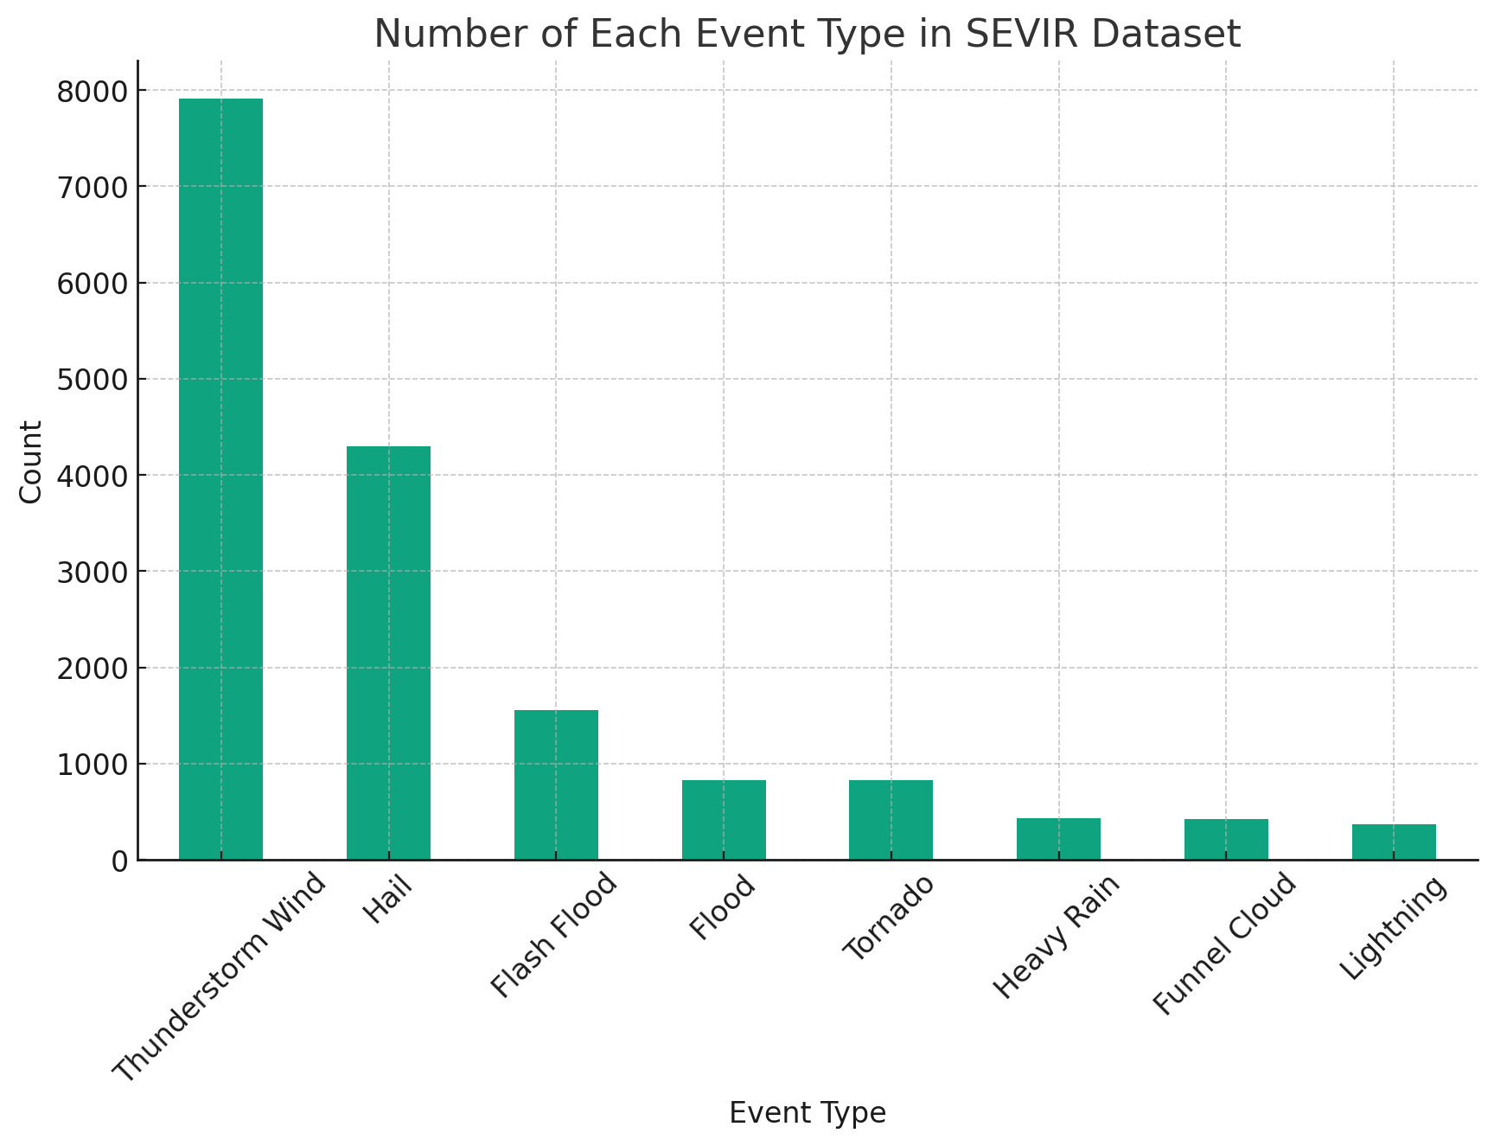
Storm Events

Slide 12
Event Characteristic
Event Frames
Spatial Resolution
Single-channel images from 5 different sensors of varied resolution
0.5 to 8 km
Event span
Temporal resolution
4-hours
5 minute steps. 49 frames total per event.

Slide 13
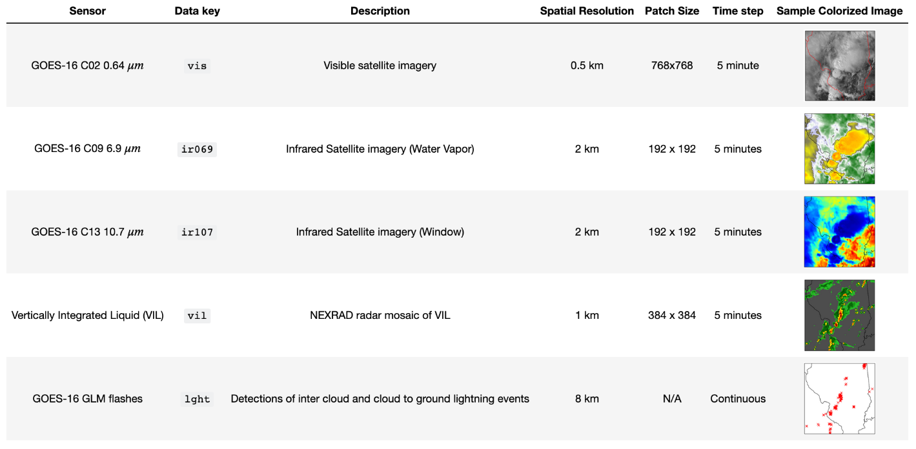
Sensor data per event
Notes:
Visible Satellite Imagery (vis): This provides conventional visible light images from satellites, useful for observing cloud cover, storm structures, and other meteorological features in visible light.
Infrared Satellite Imagery (ir069 and ir107): These two types of infrared imagery are valuable for detecting cloud heights and temperatures, which are crucial for understanding storm intensity and development.
NEXRAD Radar Mosaic of Vertically Integrated Liquid (VIL): VIL imagery from NEXRAD radar gives insights into the amount of liquid water content in clouds, aiding in the assessment of precipitation potential.
Lightning (lght): This category includes images of both intercloud and cloud-to-ground lightning events, providing important data on storm electrification and potential severity.

Slide 14
On choice of channel
Cloud top analysis
Continues Monitoring
Infrared for cloud top temperature and height
Infrared available day and night
Daytime only
Limited scope
Visible imagery limited to daylight
Lightning data not broadly informative
Notes:
Cloud Top Temperature and Height: Infrared imagery, like ir069, is effective in determining the temperature of cloud tops. Cooler cloud tops generally indicate higher and potentially more severe weather systems.
24/7 Availability: Unlike visible imagery, infrared images can be captured day and night, providing continuous monitoring capabilities.
Weather System Analysis: Infrared imagery is crucial for tracking and analyzing weather systems, especially for understanding storm development and predicting severe weather events.
Daytime Restriction (vis): Visible imagery is only useful during daylight hours, limiting its use for continuous monitoring, especially for nocturnal weather events.
Limited Weather Insights (lght): Lightning images alone may not provide comprehensive information about the broader meteorological conditions.

Slide 15
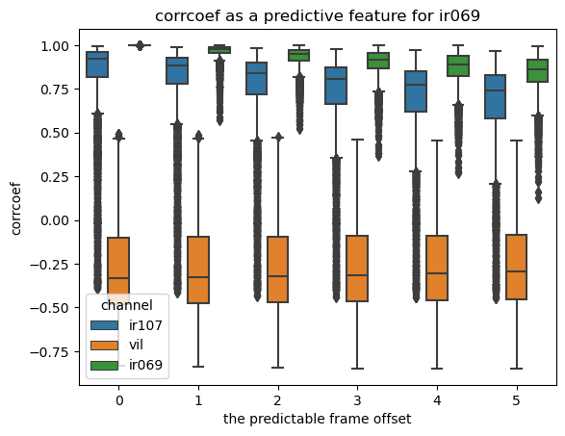
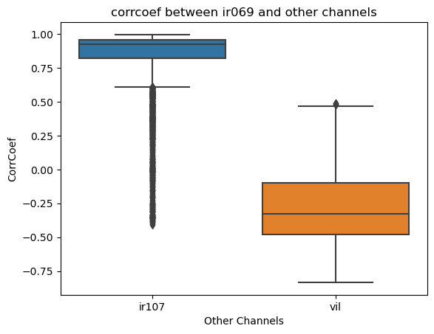
IR069 as main channel
ir069 as Main Channel: High self-correlation and strong for consistent, detailed weather analysis, especially for cloud top temperature and height. Its 24/7 availability enhances its utility as a primary data source.
ir107 as Support Channel: Its moderate to strong correlation with ir069, providing additional data for accurate predictions and analyses.
VIL : VIL offers unique insights into liquid water content, thus enriching the overall analysis. Given its low correlation with ir069, it was discarded.
Notes:
This combination leverages the strengths of each channel: ir069 for continuous and detailed observation, ir107 for reinforcing infrared analysis, and VIL for additional meteorological dimensions, creating a comprehensive multi-channel approach to weather event analysis and prediction.

Slide 16
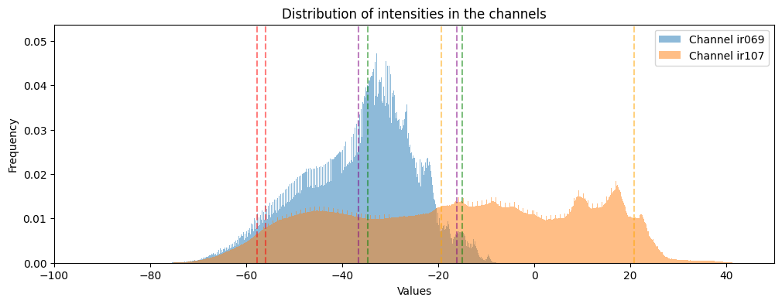
Channels Distributions

Slide 17
02
Methodology

Slide 18
Related Techniques
CNNs
RNNs/LSTMs
Extracts spatial features from weather frames, identifying cloud patterns
Processes time-series data, capturing temporal changes in weather events
Implicit Autoregressive Model
Transformers
Models long-range dependencies in sequential data
Learning implicit representations of the underlying dynamics
Notes:
CNNs for Spatial Feature Extraction: Convolutional Neural Networks are adept at extracting hierarchical spatial features from weather images, using convolutional layers to identify patterns such as cloud formations and storm structures.
RNNs and LSTMs for Sequential Data Processing: These networks specialize in processing time-series data, capturing temporal dependencies. LSTMs, in particular, are designed to remember long-term dependencies, making them suitable for predicting weather events that evolve over time.
Transformers for Complex Dependency Modeling: Originally designed for NLP, Transformers have shown promise in modeling complex, long-range dependencies in sequential data, using self-attention mechanisms to weigh the importance of different parts of the input data.
Implicit Stacked Autoregressive Model for Dynamic Video Prediction: predicting future frames in a sequence by learning implicit representations of the underlying dynamics in the data.

Slide 19
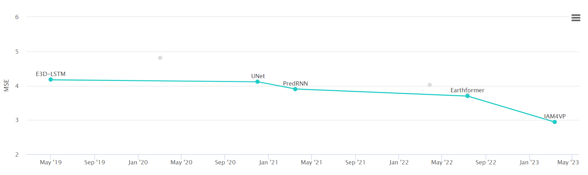
Related Techniques

Slide 20
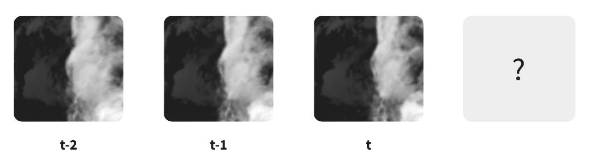
Predicting the future cloud movement
Are we able to predict what's going to happen to a cloud in the future?
Task: Input three frames, predict the next three using random noise. Denoise progressively to generate multiple future predictions post-training

Slide 21
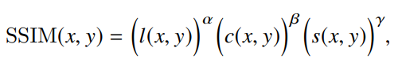
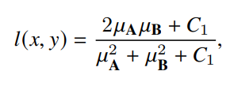
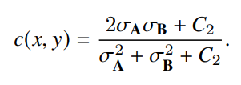
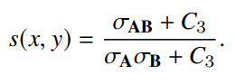
Metrics
Structural Similarity Index (SSIM)
Measures the similarity between two images, extracting structural information from a scene.
Global similarity through Gaussian Kernel convolutions, differs from MSE that measures a pixel-to-pixel similarity.
Lighting component
Contrast component
Structural component

Slide 22
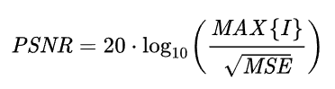
Metrics
Peak signal-to-noise ratio (PSNR)
Calculates the ratio between the maximum possible power of a signal and the power of corrupting noise that affects it.
Higher PSNR values indicate better image quality, as it suggests a lower level of noise

Slide 23
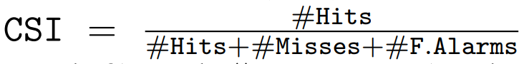
Metrics
Critical Success Index (CSI)
commonly used in precipitation nowcasting and is defined as
the prediction and the ground-truth are scaled and binarized at different thresholds. The thresholds were found by analysing the percentiles (15th, 30th, 45th) of the training dataset.
It can correctly identifying both positive and negative occurrences, by measuring the success of correctly predicting both the occurrence and non-occurrence of a cloud.
Notes:
Related to iou
The thresholds are related to cloud structure and event (water vapor or rain or some other event)

Slide 24
Forecasting future frames with Diffusion Models
Conditioning denoising process on past frames for next-frame prediction:
Condition the diffusion process on previous frame, to generate future frames
The model will learn patterns from the past frames and generate an image of the expected movement.
Condition frames are passed as channels. It has been proved in other cases to be effective in conditioning (e.g. stable diffusion depth and inpainting models).

Slide 25
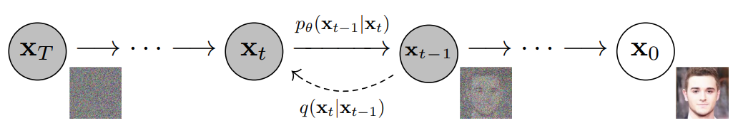
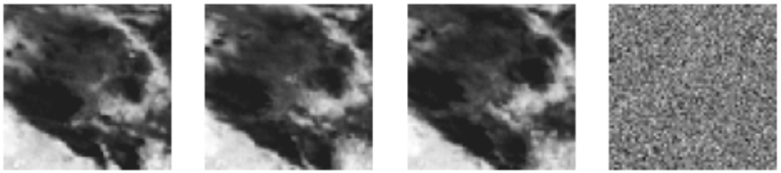
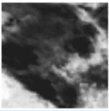
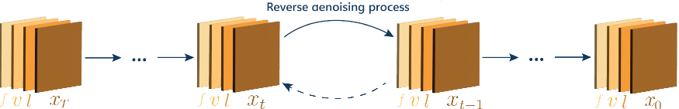
Diffusion Models work by destroying training data through the successive addition of Gaussian noise, and then learning to recover the data by reversing this noising process.
Ho et al., “Denoising Diffusion Probabilistic Models”,
https://arxiv.org/pdf/2006.13846.pdf
Notes:
A noise scheduler is defined to add noise to an image (sampled from a gaussian distribution). The forward diffusion starts from X0 and ends in Xt, where the image is considered to be pure noise (after 1000 steps of noisying).
The sampling takes the image from the data space (that has an unknown distribution) to a known distribution (the gaussian one).
By inverting the process, and teaching a predictor model (neural network) to predict the noise added, we can revert and generate an image.

Slide 26
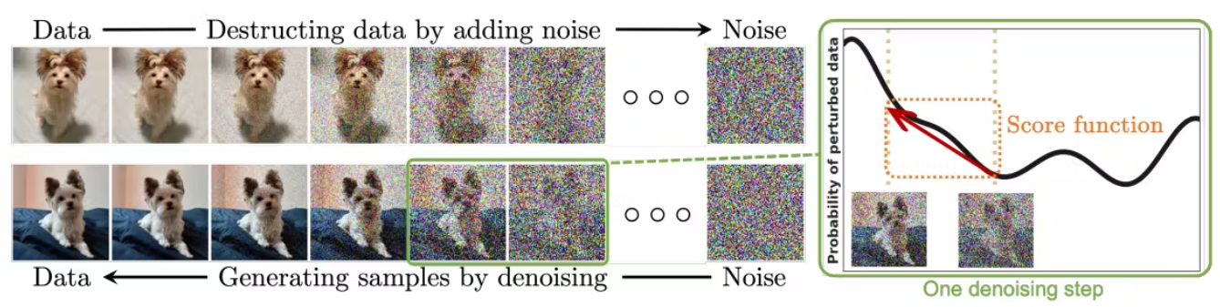
Denoising Diffusion Probabilistic Models (DDPMs)
Training DDPMs involves capturing the transformations of a sequence to random noise process, enabling the model to learn the relationship between noisy and clean data.
DDPMs operate by simulating a diffusion process that transforms noisy data into clean data samples.
Ho et al., “Denoising Diffusion Probabilistic Models”,
https://arxiv.org/pdf/2006.13846.pdf

Slide 27
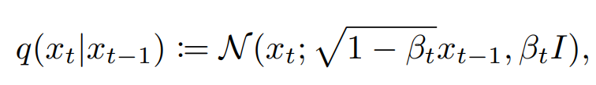
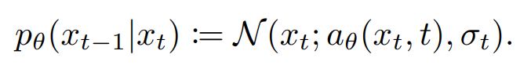
Denoising Diffusion Probabilistic Models (DDPMs)
We start with a forward (non-parametric) diffusion which gradually adds noise to data, that is transformed it into a Gaussian distribution
The generative model then learns to reverse this process and thus gradually produce realistic samples from noise. DDPM learns parameterized Gaussian transitions:
Notes:
Q is the sampling distribution
q(xt ! xt-1) is defined as a gaussian distribution
for some fixed variance schedule β1, . . . , βt. Importantly, a noisy sample xt can be obtained directly from the clean sample x0
The normal distribution is centered at 1-bxt-1 (last sample downscaled by a factor)…. And has a diagonal covariance matrix (i dont know why, probably to make computing things easier).
In practice, rather than predicting the mean of the distribution in Equation (2), the noise predictor network θ(xt, t) predicts the noise component from the sample xt and the step t; the mean is then a linear combination of this noise component and xt. The covariances σt can be either fixed or learned as well;
the noise predictor θ(xt, t) is tightly related to the score function

Slide 28
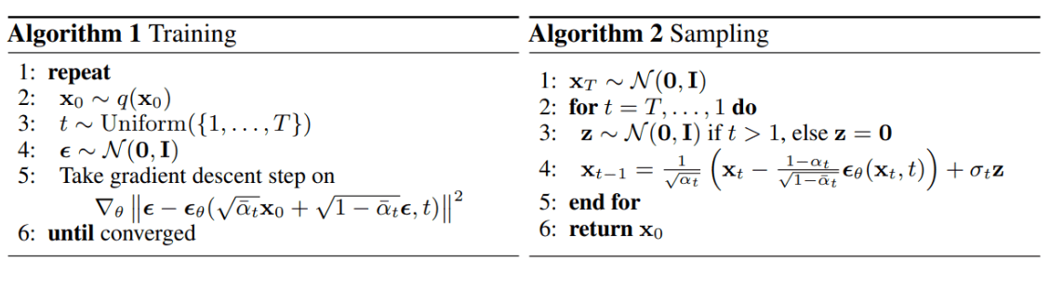
Denoising Diffusion Probabilistic Models (DDPMs)
Ho et al., “Denoising Diffusion Probabilistic Models”,
https://arxiv.org/pdf/2006.13846.pdf
Notes:
q(xt ! xt-1) is defined as a gaussian distribution
for some fixed variance schedule β1, . . . , βt. Importantly, a noisy sample xt can be obtained directly from the clean sample x0
In practice, rather than predicting the mean of the distribution in Equation (2), the noise predictor network θ(xt, t) predicts the noise component from the sample xt and the step t; the mean is then a linear combination of this noise component and xt. The covariances σt can be either fixed or learned as well;
the noise predictor θ(xt, t) is tightly related to the score function

Slide 29
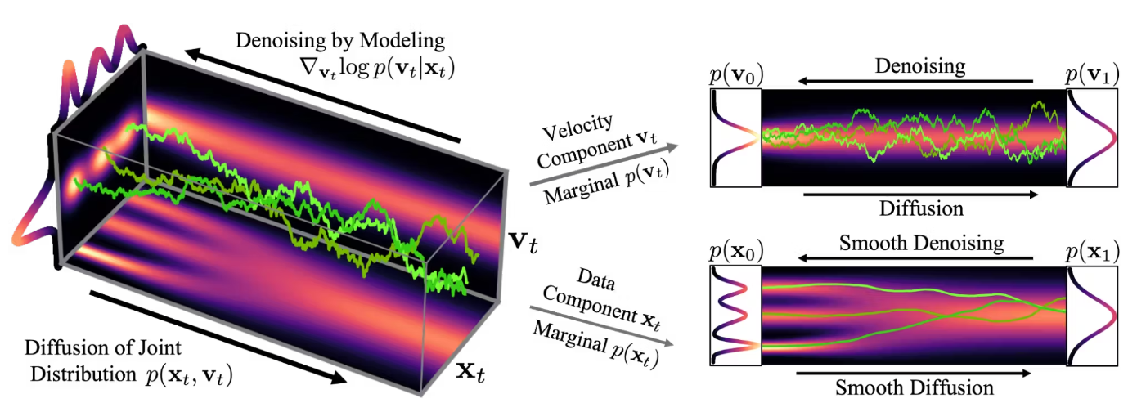
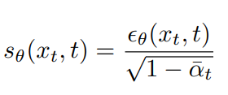
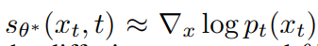
Score Based Generative Models (SGMs)
SGMs utilize the score function, derived from the log-likelihood gradient with respect to data, to estimate the probability density of data points. This function offers crucial insights into the local structure of the data distribution.
Notes:
the noise predictor θ(xt, t) is tightly related to the score function of the intermediate distributions.
sθ ∗ (xt, t) ≈ ∇x log pt(xt), with pt(xt) being the density of the target distribution after t steps of the diffusion process and θ ∗ are the parameters at convergence
The role of the network is to estimate the distribution.

Slide 30
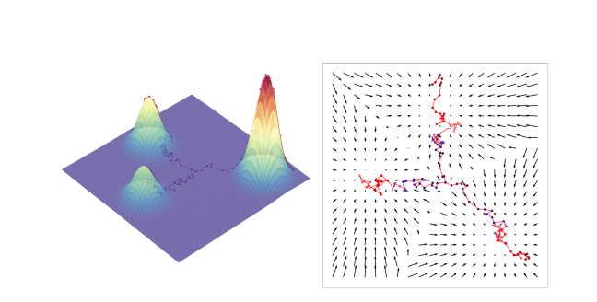
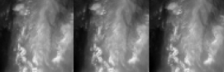

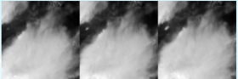
Score Based Generative Models (SGMs)
Notes:
the noise predictor θ(xt, t) is tightly related to the score function of the intermediate distributions.
sθ ∗ (xt, t) ≈ ∇x log pt(xt), with pt(xt) being the density of the target distribution after t steps of the diffusion process and θ ∗ are the parameters at convergence
The role of the network is to estimate the distribution.
score function, derived from the log-likelihood gradient
The role of the network is to estimate the distribution.
the noise predictor θ(xt, t) is tightly related to the score function

Slide 31
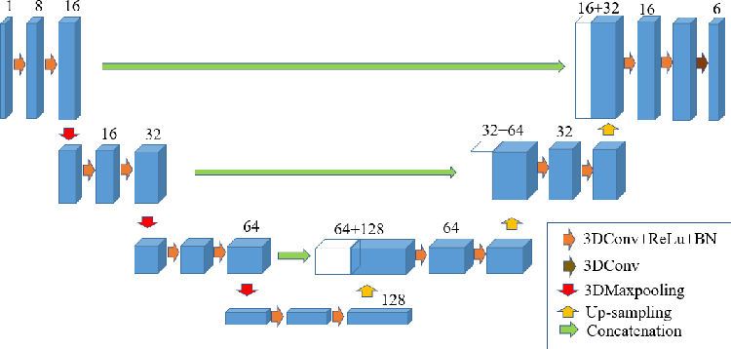
UNet Architecture
Parameters
Cin
Cout
Input shape: (C_{in}, H, W)
Output shape:(C_{out}, H, W)
Cin = input channels
Cout = output channels
H = Height
W = Width

Slide 32
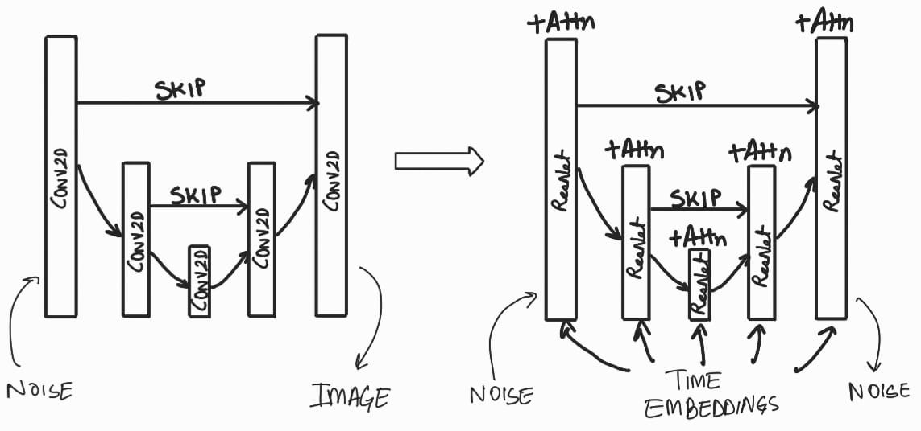
UNet Conditioned Architecture

Slide 33
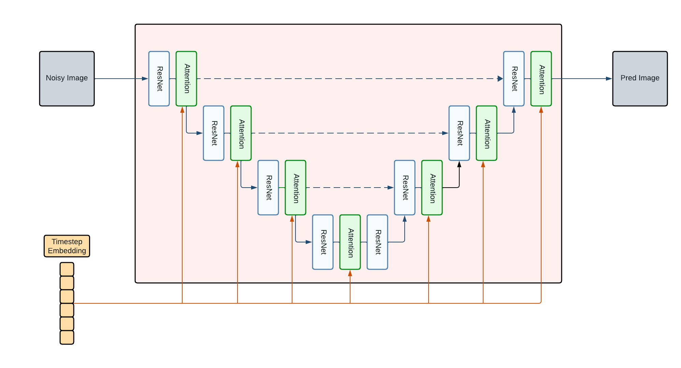
UNet Conditioned Architecture
Error: should be PRED NOISE
Notes:
Add what is the unet doing (input and output)
What is the role of it

Slide 34
UNet Conditioned Architecture
Notes:
Add what is the unet doing (input and output)
What is the role of it

Slide 35
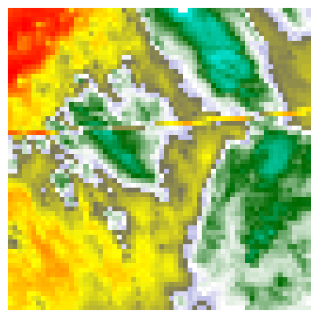
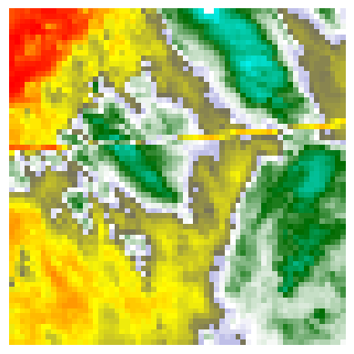
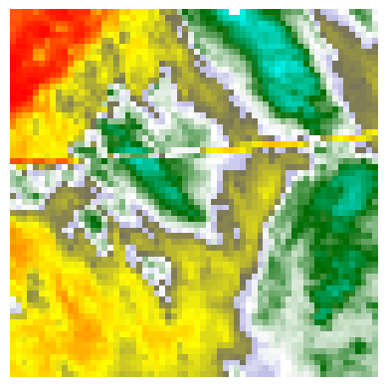
Autoregression Process
DDPM Sampling
Concatenate
. . .
A
B
C
D
B
C
D
Repeat N steps

Slide 36
Models Definitions

Slide 37
Baseline models
Use of simple UNet 2D as a base model
All predictions are made using the ir069 channel
Model | Explanation
Baseline without autoregression | Uses 3 input frames and 3 nosified frames and predicts the noise of the 3 nosified frames. During inference, it predicts the next three frames directly.
Baseline with autoregression | Uses 3 input frames and 1 nosified frame and predicts the noise of the noisified frame. During inference it applies autoregression 3 times.
Baseline with autoregression multichannel | Same as Baseline with autoregression, but also uses ir107 channel to predict the noise.

Slide 38
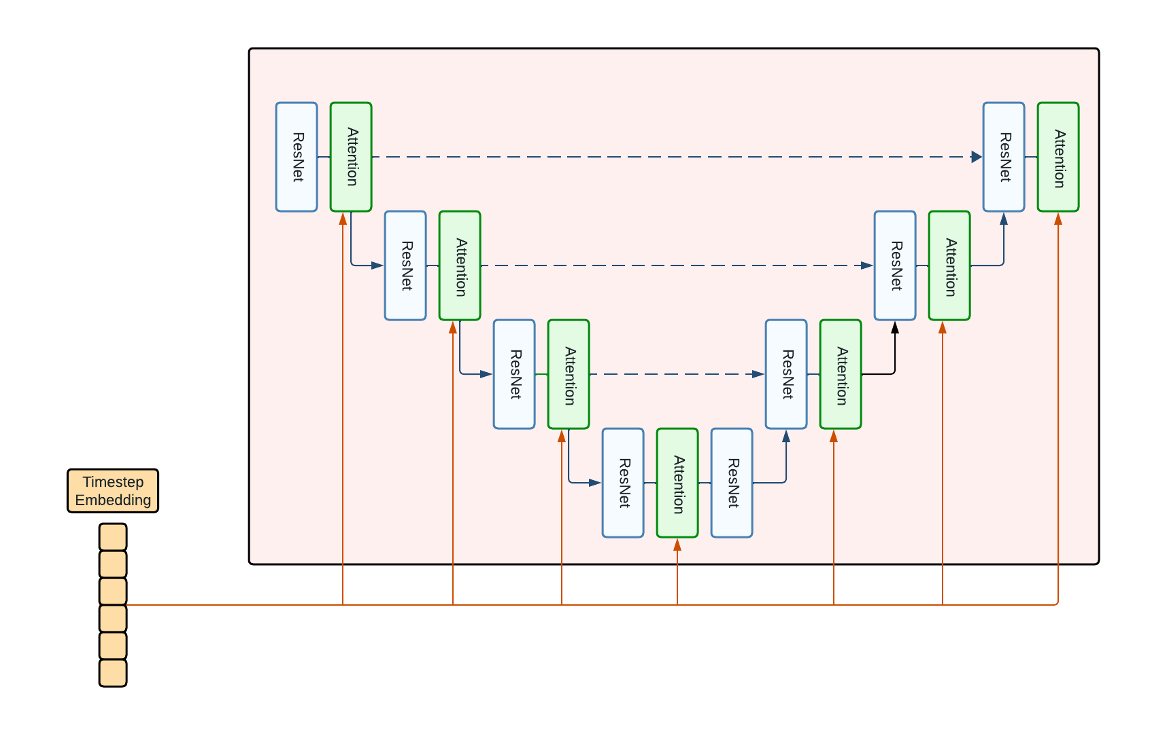
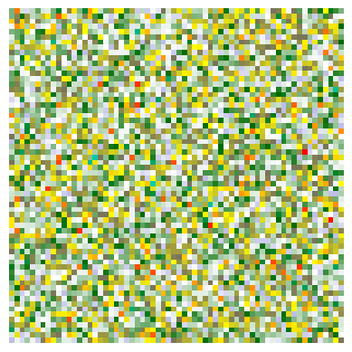
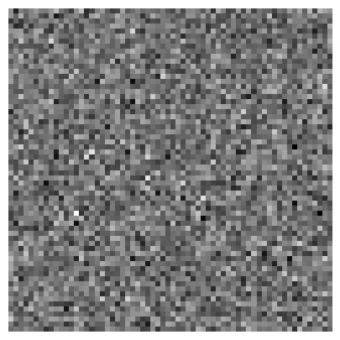
Baseline without autoregression prediction
Input Frames
Nosified Frames
Noise
Timestep T

Slide 39
Baseline without autoregression
inference
DDIM Sampling
Input Frames
Output Frames
Repeat N steps

Slide 40
Baseline with autoregression prediction
Input Frames
Nosified Frames
Noise
Timestep T

Slide 41
Baseline with autoregression
inference
Input Frames
Autoregression
Autoregression
A
B
C
B
C
D
C
D
E
Output Frames
Autoregression
D
E
F

Slide 42
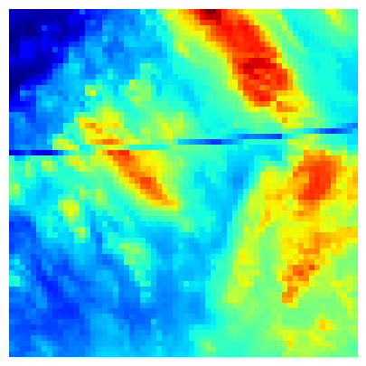
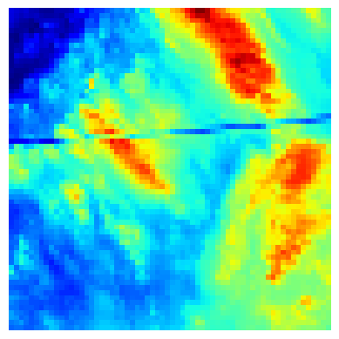
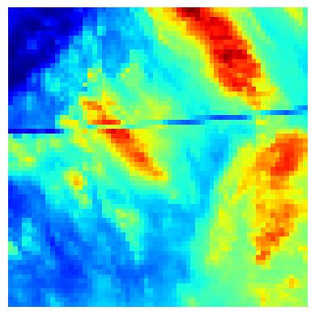
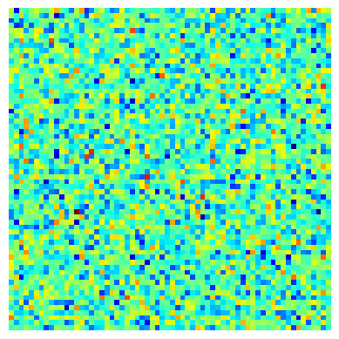
Baseline with autoregression multichannel prediction
Input Frames
Nosified Frames
Noise
ir069
ir172
ir069
ir172
ir069
ir172
ir069
ir172
Timestep T
ir069
ir172

Slide 43
Baseline with autoregression multichannel inference
Input frames
Autoregression
ir069A
ir172A
ir069B
ir172B
ir069C
ir172C
ir069B
ir172B
ir069C
ir172C
ir069D
ir172D
Autoregression
Output frames
Autoregression
ir069D
ir172D
ir069E
ir172E
ir069F
ir172F
ir069C
ir172C
ir069D
ir172D
ir069E
ir172E

Slide 44
ConvGRU + UNet Architecture
Try to capture the temporal information between input frames through a ConvGRU ¹ Architecture and encode them.
Pass the encoded temporal information and the nosified future frames to the 2D UNet in order to predict the noise of the future frame.
We used it because we thought it could lead to better result than the baseline
We use ConvGRU instead of ConvLSTM, because GRU architectures are faster in inference
[1] Siam et al., “Convolutional Gated Recurrent Networks for Video Segmentation”, 2016, https://arxiv.org/abs/1611.05435
Notes:
In order to face the fact that time component was not really captured by these baseline architectures, as they are actually encodin spatial information through a 2D Unet we decided to experiment with different ideas which could include and encode more tightly this temporal kind of information present in the data.

Slide 45
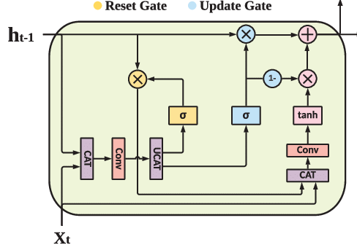
ConvGRUCell
Mixes GRU with convolution. Captures temporal information in the image domain.
Concatenation
Splitting operation
Convolution
Multiplication
Addition
Sigmoid
hyperbolic tangent
subtracts from 1 the input
Input x_{t} (C_{in}, H, W); Output (C_{in}, H, W)
Hidden state h_{t-1} (C_{in}, H, W)
CAT
UCAT
Conv
σ
tanh
1-
Notes:
Mixes GRU with convolution operations, in order to capture temporal information considering the spatial information of images
Input, output and hidden state have same shape.
Concatenates x_{t} and h_{t-1} and applies convolution, then split in 2
Passes first split through the reset gate, second split through the update gate
Reset gate result is multiplied with h_{t-1}
Reset gate result is concatenated with x_{t} then convolution is applied followed by hyperbolic tan function
This result is multiplied by 1 - result of update gate
This result is added to result of uodate gate multiplied with h_{t-1}

Slide 46
ConvGRU*
Input Frames
A
B
C
Hidden
sate 0
Hidden
sate 1
Hidden
sate 2
Hidden
sate 3
ConvGRUCell
ConvGRUCell
ConvGRUCell
* 2 ConvGRU layers are used in our experiment

Slide 47
ConvGRU models
All predictions are made using the ir069 channel
They all use 3 input frames and 1 nosified frame
All apply autoregression 3 times during inference. The inference process is the same as Baseline with Autoregression
Model | Explanation
ConvGRU (last hidden state) | Applies Conv GRU to the input frames and concatenates the last hidden state to the nosified frame.
ConvGRU (last hidden state and last frame) | Applies Conv GRU to the input frames and concatenates the last hidden state to the last input frame and the nosified frame.

Slide 48
ConvGRU (last hidden state) prediction
Input Frames
Nosified Frame
Timestep T
Noise
ConvGRU
Last hidden state
Last
hidden
state
Nosified Frame
Concatenate

Slide 49
ConvGRU (last hidden state and last frame) prediction
Input Frames
Nosified Frame
Timestep T
A
B
C
Noise
ConvGRU
Last hidden state
Last
hidden
state
Nosified Frame
C
Concatenate
Notes:
The idea behind it is to enforce the temporal encoding by adding the last input frame and thus re-introducing information

Slide 50
3D Space-Time Unet
SOTA text to video generator from Meta AI
Innovative Spatial-Temporal Modules:
By using decomposition and approximation, the spatial-temporal modules break down the full temporal U-Net and attention tensors, approximating them in space and time.
It combines pseudo-3d convolutions (axial convolutions) and temporal attention and shows much better temporal fusion, enable the diffusion model to capture the temporal relationships between cloud’s movements.
[1] Singer et al., “Make-A-Video: Text-to-Video Generation without Text-Video Data”, 2022, https://arxiv.org/abs/2209.14792
[1] Siam et al., “Convolutional Gated Recurrent Networks for Video Segmentation”, 2016, https://arxiv.org/abs/1611.05435
Notes:
By integrating factorized space-time attention layers, the approach aims to efficiently incorporate temporal dynamics into Unet network.

Slide 51
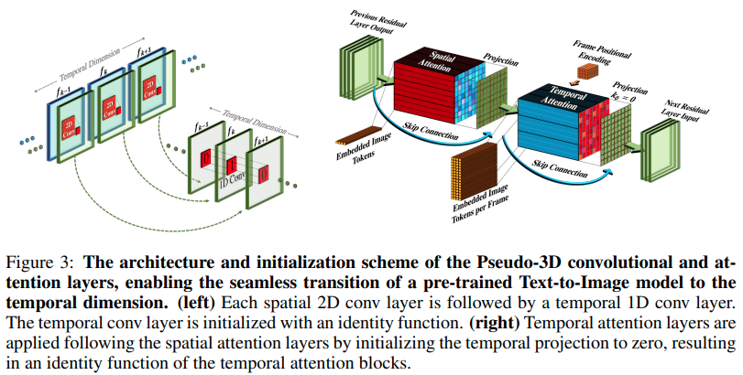
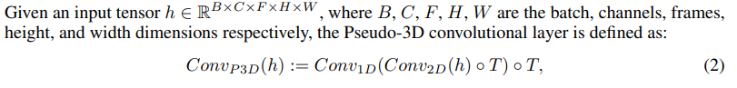
Pseudo 3D convolutions

Slide 52
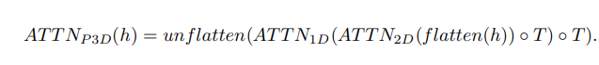
Pseudo 3D Attention layers
3D attention is achieved by stacking temporal attention layers following spatial attention layers, approximating a full spatiotemporal attention layer.
An additional 3x1x1 convolution projection is applied after each 1x3x3 convolution, ensuring temporal information permeates through each layer

Slide 53
3DUnet models
Use of simple UNet 2D as a base model
All predictions are made using the ir069 channel
Model | Explanation
3D Unet with autoregression | Uses 3 input frames and 1 nosified frame and predicts the noise of the nosified frame. During inference it applies autoregression 3 times.
3D Unet without autoregression | Uses 3 input frames and 3 nosified frames and predicts the noise of the 3 nosified frames. During inference, it predicts the next three frames directly.

Slide 54
3D Space Time UNet with Autoregression
Input Frames
Nosified Frame
Noise
Timestep T

Slide 55
3D Space Time UNet without Autoregression
Input Frames
Nosified Frames
Noise
Timestep T

Slide 56
03
Implementation

Slide 57




Technology stack

Slide 58
Dataset Split
200
8
40
?
?
?
?
Train
Validation
Test
Random Events 2018
Random Events 2018
Storm Events 2019
5 per kind
* Each event composed by 49 frames
Notes:
The events have been fetched randomly in both the train, validation and test sets.
We use Random Events in the Train and Validation Datasets in order to train a general cloud movement forecasting which would work on any kind of meteorological event.
We use Storm Events in the test set, because we want to evaluate the goodness of the model on events that could be of meteorological interest, and whether the model can forecast them correctly.
We use such a limited number of validation events because the inference of diffusion models is particularly slow.
The total number of selected event is as well constrained by memory limitations (RAM limit on colab for a greater number of events)
The test set used events from te subsequent year in order to avoid any kind of data leakage in the evaluation (possibility of presence of training or evaluation instances in the test set)

Slide 59
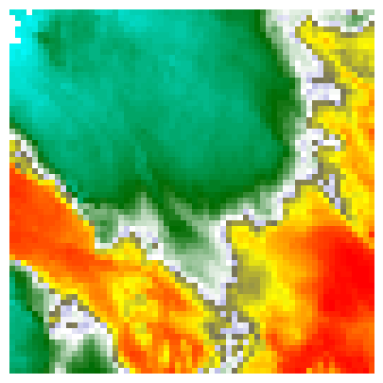
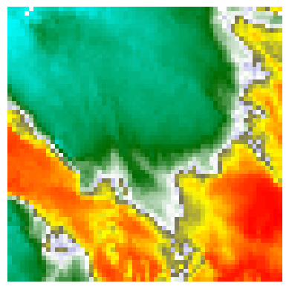
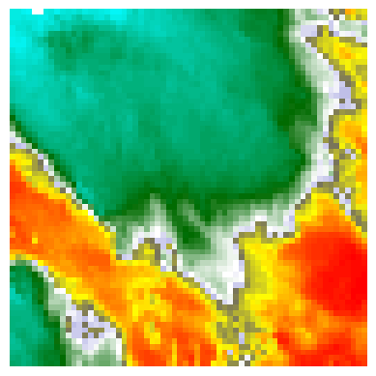
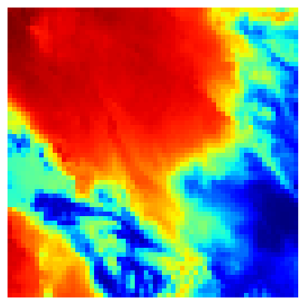
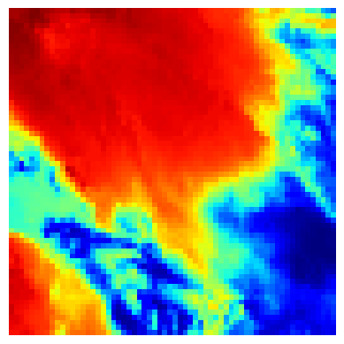
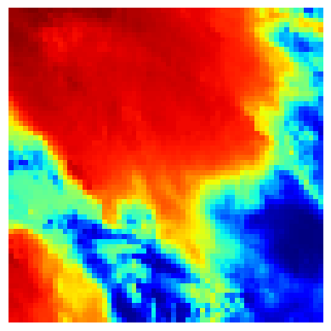



Dataloaders
Train
Validation and Test
Input frames + Nosified frame
Temperature
Noise
Input frames
Target frames

Slide 60
Training Epoch
Get Train Batch
Model Prediction
Input frames
Temperature
Noise
Predict the noise from input frames and temperature
1
2
Validate
Compute Loss
Every 5 epochs
6
3
Error between noise and predicted noise
5
4
Optimization
Backpropagate

Slide 61
Training Epoch
Train Batch
Model Prediction
Backpropagation and Optimization
Input frames + nosified
Predicted Noise
Timestep
Noise
Loss
Next Batch

Slide 62
Validation
Apply eventual autoregression
Validation Batch
DDPM Sampling
Validate
mCSI; PSNR; SSIM; MSE;
Input frames
Predicted
Frames
Target frames
Repeat N steps

Slide 63
Settings
Autoregression
Loss
Experimented for all models
MSE
Gradient Clip
Checkpoint
Used for 3D Unet without autoregression
On best Validation mCSI on the ir069 channel

Slide 64
Hyperparameters
Epochs
Batch Size
100
With validation every 5
128 for Baselines and GRU
16 for Space-Time UNets
Frames Size
Optimizer
64x64
AdamW
with weight decay = 1e-2
Sampling Steps
Learning Rate
1000 on training
333 on validation
5e-4
with One Cycle Scheduling ¹
[1] Smith et al., “Super-Convergence: Very Fast Training of Neural Networks Using Large Learning Rates”, 2018, https://arxiv.org/abs/1708.07120

Slide 65
Training history of Space-Time UNet without autoregression
Example Insight

Slide 66

Training history
Insight
Train and Validation MSE converge overtime
No sign of overfitting

Slide 67



Validation history

Slide 68




Frame Prediction History
Target frames
Predicted frames
Step 2101
Step 6105
Step 8107

Slide 69
04
Results

Slide 70
Settings
Validation
Test
Validation results are shown for the different models considering the ir069 channels
Test results are shown for the selected best model considering the ir069 channels: Space-Time UNet without autoregression

Slide 71

Validation mCSI
Best models
Space-Time UNets
Worst Models
Baseline without autoregression
Other
Multichannel performs bad;
GRU models don’t improve

Slide 72



Other Validation Metrics
SSIM
PSNR
MSE
Notes:
Similar to mCSI, MSE particularly worse for baseline without autoregression.

Slide 73

Training Times
Fastest model
Baseline Without Autoregression
Slower models
Space-Time UNets
Other
The GRU models are quite fast in training time, with average performances

Slide 74






Frame Predictions at Checkpoint
Model | Predicted Frames | Actual
Baseline without Autoregression
Baseline with Autoregression
Baseline with Autoregression Multichannel
ConvGRU (last hidden state)
ConvGRU (last hidden state and last frame)
Space-Time UNet with Autoregression
Space-Time UNet without Autoregression

Slide 75

Validation mCSI vs Model Size
Insight
Baseline models and GRU models have roughly same size ≈10^{6.5} parameters
Space-Time UNet Models perform better, but have ≈10^{7.7} parameters.

Slide 76

Validation mCSI vs Model Size
Insight
Baseline without autoregression has more parameters than other Baseline and GRU models but performs worse.

Slide 77
Best model: Space-Time UNet without
Autoregression
PROS
Among Best Validation mCSI: 0.87
Avoids autoregression extra Inference time
Acceptable inference time. ≈ 25 seconds per instance to predict next 15 minutes
CONS
Large parameters size

Slide 78

Test mCSI
Best results
Flash Flood Thunderstorm Wind
Worst results
Hail

Slide 79



Other Test Metrics
SSIM
PSNR
MSE
Notes:
SSIM and PSNR pretty similar for all events.
Hail and Tornado worse for SSIM
Tornado worse for PSNR
Tornado strangely much worse for MSE, but not the best reliable metric

Slide 80


Best Results Analysis
Target frames
Predicted frames
Insight
Flash Flood
Frames to predict are mostly homogeneous, lacking of intricate details
Thunderstorm Wind

Slide 81

Worst Results Analysis
Target frames
Predicted frames
Insight
Hail
Frames to predict are rich in detail and intensity variation. Harder to predict correctly

Slide 82
Limits
Computation & Latency
Data & Availability
Stochasticity & Uncertainty
Diffusion models are computationally intensive and have inherent latency, challenging real-time predictions.
Require extensive, high-quality data and have diverse structures that hinder availability.
Their Stochastic nature generates diverse outcomes but complicates uncertainty quantification.
Notes:
Computation & Latency: The iterative refinement process in diffusion models is computationally demanding. This aspect limits their applicability in scenarios needing quick responses, such as real-time weather forecasting or nowcasting, where rapid updates are crucial.
Data & Interpretability: The effectiveness of diffusion models hinges on access to large datasets of high quality. However, obtaining such comprehensive data for all weather conditions can be challenging. Additionally, the internal workings of these models are complex, making it difficult to understand how they arrive at specific predictions, which is a crucial factor for model trust and validation.
Stochasticity & Uncertainty: While the stochastic nature of diffusion models is beneficial in exploring a range of possible outcomes, this feature also introduces variability. It can be challenging to discern the most likely weather scenario amidst this variability. Moreover, while these models can generate diverse predictions, quantifying the uncertainty of these predictions in a way that is meaningful and actionable for decision-makers is still a significant challenge in the field.

Slide 83
Future work
Implement a strategy to maintain a mid-level noisy frame across prediction intervals, reducing complete denoising at each step for efficiency.
Temporal Consistency
Efficiency
Focus:
Determining the best noise level (tradeoff) and assess its effect on the forecast
Real-time adaptive noise adjustment tailored to evolving weather conditions
Notes:
Concept Overview: Introduce the strategy of maintaining a mid-level noisy frame over several prediction intervals, reducing the need to denoise from full noise at each step.
Potential Advantages:
Efficiency: By avoiding complete denoising at each step, this method could significantly reduce computational demands.
Temporal Consistency: Maintaining a mid-level noisy state could capture the temporal consistency of weather patterns more naturally.
Rapid Updates: This approach could enable more rapid model updates, aligning better with the nowcasting timeframes.
Operational Workflow:
Start with a frame at an optimal noise level.
For each forecast step, apply only the final stages of denoising.
Adaptively adjust the noise level based on the observed changes in weather patterns.
Research Implications:
Investigate the optimal noise level that balances forecast quality with computational efficiency.
Develop algorithms for adaptive noise management based on real-time data.
Explore the trade-offs between noise level and forecast horizon for different weather events.
Adaptive Ensemble Modeling:
Dynamic Noise Adjustment: Propose a method for dynamically adjusting the noise levels in response to evolving weather conditions, tailoring ensemble members to current weather dynamics.
Selective Denoising: Apply selective denoising only to the most influential ensemble members, focusing computational resources where they have the most impact on the forecast.

Slide 84
Thanks!
Do you have any questions?
facundo.maidana@studio.unibo.it
farshid.mahmoudabadi@studio.unibo.it
riccardo.spolaor@studio.unibo.it

